Slide 1
ECE 3740 Systems Engineering Principles Project 5
Mohammad Elsayyed

Slide 2

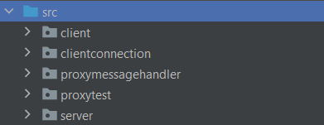
ECE 3740 Systems Engineering Principles Project 5
From previous project, we already have the client (Android app) and the server (MX7ck) board.
Therefore, I implemented Design 2:
The proxy server functions both as a server and a client.
Server refers to the Proxy being the Server and the Android being the client
Client refers to the Proxy being the Client and the Board being the client
Another added feature is the proxy server connection to the Mx7cK Board, so the if a disconnect occurs it only happens between android and that corresponding server part of the proxy server, never the Board.
As shown, here’s the Proxy server
Package structure to be explained in these
Upcoming PowerPoint slides.

Slide 3
Design Example #2: Connect Sequence Diagram
MX7cK Server
Proxy Server
Android Client
MyServer
Client Socket
App
ServerSocket
ClientA:Socket
App
Client Socket
create
create
listen
listen
create
connect
Connection
request
Connection
established
create
connect
Connection
request
Connection
established

Slide 4
Design Example #2: Android Temperature Request from Server (Already Connected)
MX7cK Server
Proxy Server
Android Client
MyServer
Server Socket
Client Socket
App
ServerSocket
ClientA:Socket
App
Client Socket
Send “te”
By Temp. Button
Once the
“0xFF” received.
The command is processed
Command
Passed to
Message
Handler
Send “te”
Send byte “0xFF”
Command
Put on the outstream
To Board
Command Flushed.
Returns Temperature
And Byte (0xFF)
Flush Temperature with byte (0xFF) to android
Flush
Temperature
And Byte (0xFF)
Temperature
Passed & Processed by
Message
Handler
Temperature
Put on the outstream to
Android
Temperature
Passed & Processed by
Android Message
Handler, and Temperature is printed

Slide 5
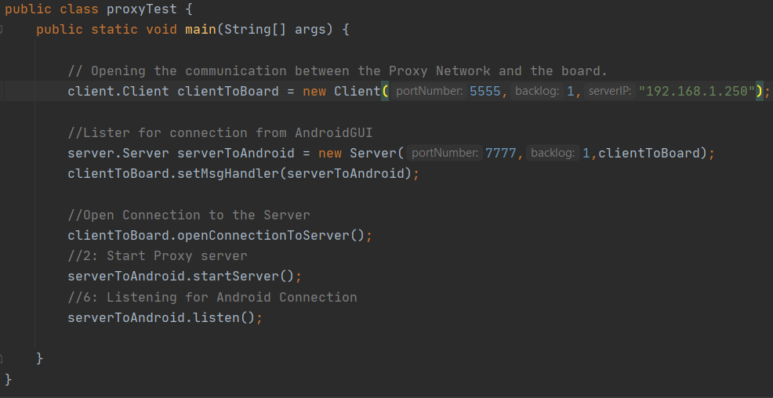
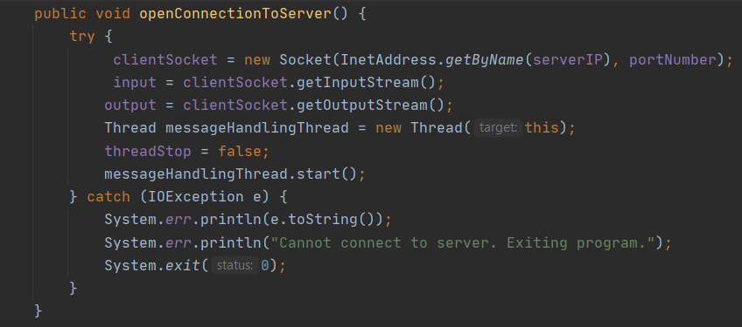
Class Proxy Test Explanation #1
In proxyTest Class,
Client Mode:
We only “initialize” the Client/Client Socket (ClientToBoard) that connects between our proxy server and the Mx7ck board, given the portNumber that the server listens to (5555), backlog (which’s not really useful in our scenario), the IP Address of the board.
Server Mode:
We start by initializing “our” proxy Server Socket to allow any client (i.e. Android) to connect later on and we specified that the port we’re listening for client connections on is (7777), any client should try to connect on that port number in order to reach our proxy Server
Client Mode: #2 (Code shown in the next page)
By calling the clientToBoard.openConnectionToServer(), we start setting the clientSocket to the given server IP and portNumber. and establishes the input and output stream of the client socket, followed by creating and starting the message Handling thread to handle any message coming (ProxyMessageHandler, explained later) from the board to be sent eventually to android.

Slide 6
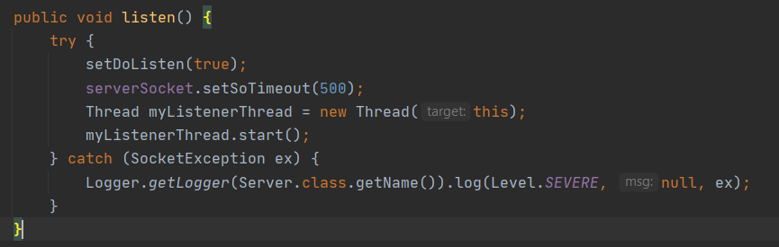
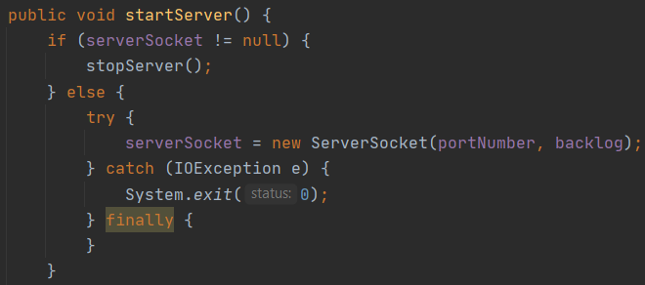
Class Proxy Test Explanation #2
In proxyTest Class,
Server Mode:
After opening and establishing the connection between the board and our proxy server,
we try to create a server socket and binds it to the specified local port we assigned earlier, to allow Android to connect to it if requested to.
Then we start listening, by starting the listening thread, anticipating for any client (Android) connection by listening to the board on the specified port number (7777).
Of course, if the Server socket couldn’t be created because the specified port is occupied by another software, we would handle that and throw an exception corresponding to the problem to the user.

Slide 7
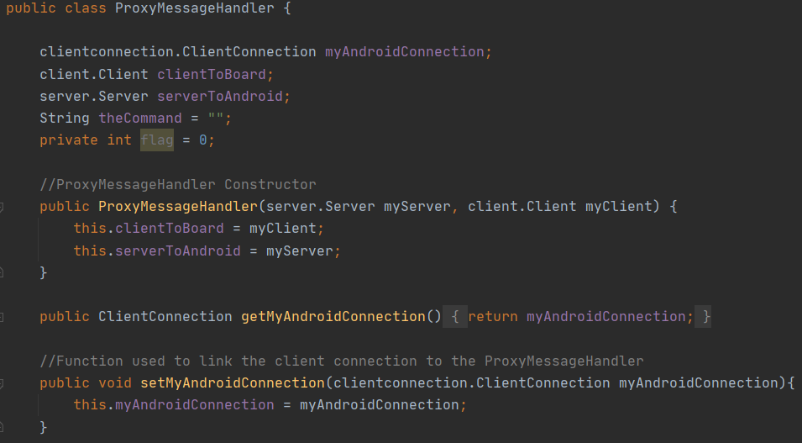
Class ProxyMessageHandler Explanation #1
In class ProxyMessageHandler,
We pass both the server we made and the client, since it’s bidirectional message handler that passes the messages to the corresponding side,
(Android → Proxy → Board) or
(Android ← Proxy ← Board).
Basically acting as a middle man, or mail man for messages.
Also, introduced the function setMyAndroidConnection, which basically sets the client connection
Initialized at the file initially, to be connected once we start our client connection to Android.
One of the accessor methods I added is getMyAndroidConnection, which returns the connection between my proxy server, and android in case I needed to send something outside the scope of the Message handler, I added it for more robustness of the code.

Slide 8
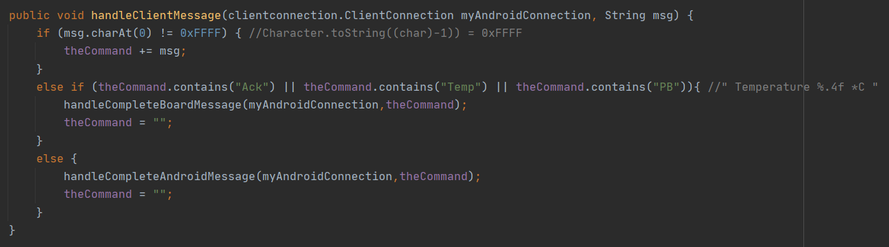
Class ProxyMessageHandler Explanation #2
handleClientMessage method: Basically since both the board, and Android send both a (0xFF) termination byte after their command/Message
We keep storing the command coming from either sides, into the theCommand variable and once the byte 0xFF is detected we start analyzing them, if the message contains the string “Ack”, or “Temp” or “PB”, this means this’s a message sent from the board to indicate either a push button status or Acknowledgement for the status of LED’s or Pushbutton status (i.e. PBUp), otherwise it’s a message from android. Once we send the message to the handler and do the purpose required we need to clear “theCommand” variable to be ready for any other message to be sent by either sides.
If the message is sent from Android we handle it in: handleCompleteAndroidMessage() method.
If the message is sent from Board we handle it in: handleCompleteBoardMessage() method.

Slide 9
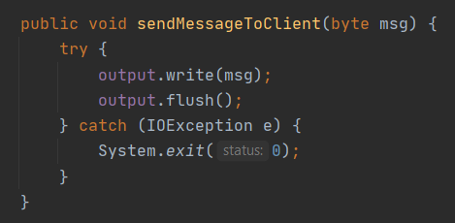
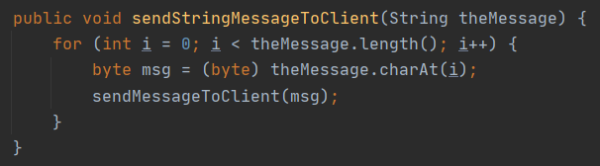
Class ProxyMessageHandler Explanation #3
This method simply passes both “theCommand” and the termination byte to two different methods, both of them end by putting the data on the corresponding AndroidConnection output stream then flushes it, however this’s done in a byte manner that’s why for the string function I break the string into letters (bytes), then pass it to the method that handles a single byte.
Note: This’s is in Client Connection class

Slide 10
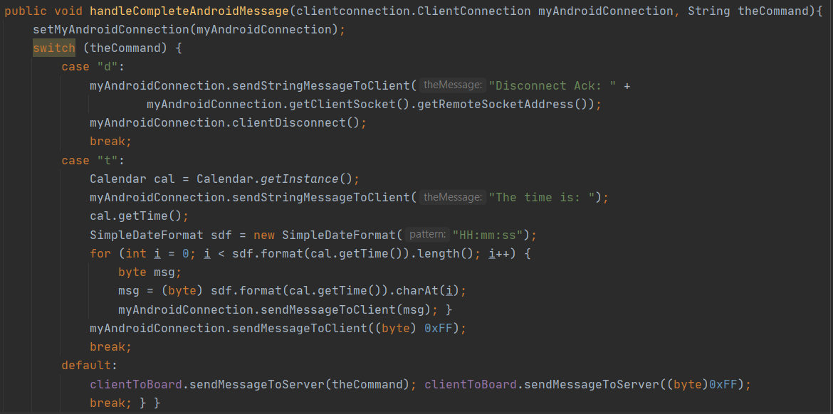
Class ProxyMessageHandler Explanation #4
In this method,
Based on the command coming from the board we handle it,
If the theCommand passed is:
Case “d”: we send a disconnection acknowledge message to the Android messages window and clear the socket connection.
Case “t”: gets the time of the local machine and send each number as a byte to the Android message handler to be displayed.
The reason we handle letter “t”, and “d” here in the proxy server, is the fact that design two allows us to always keep the connection between the board and the server open, so the actual disconnection happens between proxy server and android only, and for “t” because the board doesn’t provide time.
default: (basically otherwise): We would send the received from android message/request and send/pass to the Board, followed by the acknowledge message which’s handled in our normal handler on the server side on the board.

Slide 11
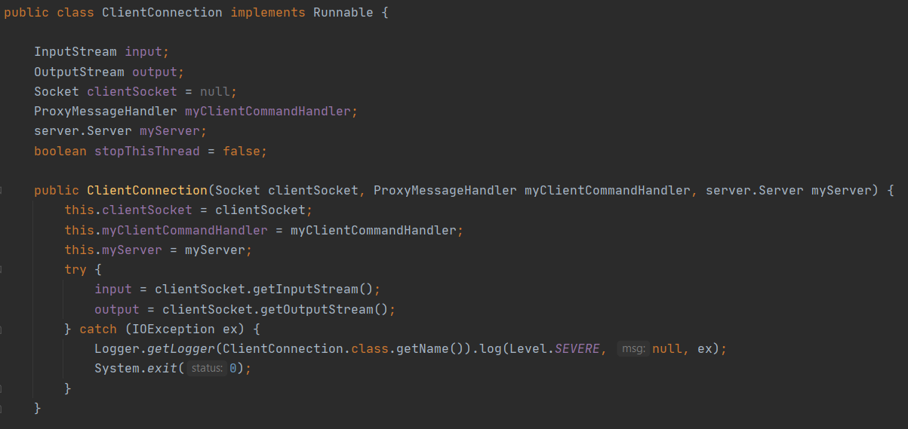
Class ClientConnection Explanation #1
In the ClientConnection constructor,
We pass the client Socket to initialize it the proxy message handler variable and the serverToAndroid that will be anticipating an android connection, and this’s going to be called once a request to connect is receive on the listening thread in the ServerToAndroid part.
Once this constructor is called and the proper variables are passed, we try to initialize an input and output streams for the data exchanging between the proxy server and android, if it failed for any reason, an exception caught and thrown.

Slide 12
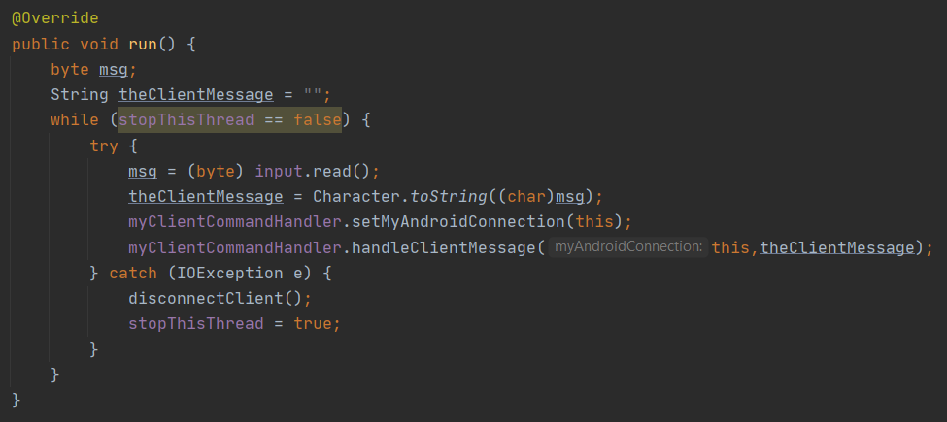
Class ClientConnection Explanation #2
In the ClientConnection,
This’s the run method that gets executed whenever a socket is made and bind between our proxy server and the client connection.
This method reads each byte send from android to our proxy server,
Then casts this byte into a string, then set’s the android connection in the message handler to the current one using the helper method, then again passes the client connection as well as the casted message which’s basically 1 char, casted to string to be handled as explained before in the Proxy message handler. (The fact that we set the global variable inside myAndroidConnection, then pass it again in the constructor is a bit redundant but it was done for testing purposes and needed in other cases.)

Slide 13
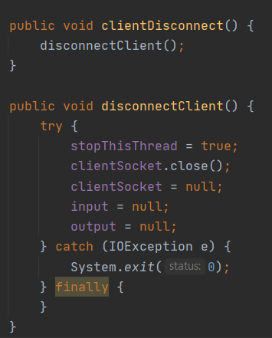
Class ClientConnection Explanation #3
getClientSocket() method, returns the ClientSocket which’s really not useful, but it’s used in the only the disconnection message.
Disconnect client() method,
Basically stops the thread of the client connection class, why does this thread even exists? Because this class allows us to connect multiple clients to our proxy server and serve them at the same time, on different threads.
Then we close the socket between the proxy server and the Android client, which in return closes the output and input stream we made earlier, and to double check on what we did again we assign socket,input stream and output stream to null, otherwise through an exception and shutdown the system and display an error message.

Slide 14
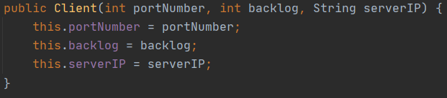
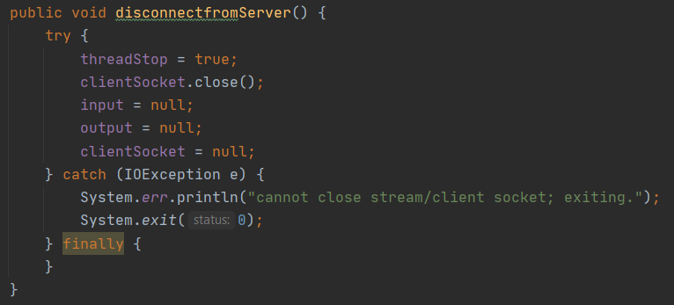
Class Client Explanation #1
This’s the client constructor, basically setting the port number, backlog, and Server IP Address that later on we will try to connect to establish the connection using that client to connect to the board.
This method is very similar to disconnect client in functionality, (Explained, in the previous slide).

Slide 15
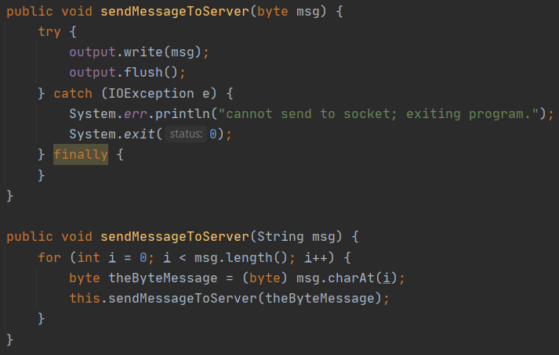
Class Client Explanation #2
Again as explain before these are method
That write on the output stream to write the data on the output stream and flush it in a byte oriented manner.
The second method is an overloaded method that breaks a string message into bytes and passes 1 byte at a time, by looping on the entire message length, to the other method to do what I explained above.
This setMsgHandler method is very important,
Since we have a common Client(Android) and Server (Board), based on my design I initialized the proxy command handler whenever I established a connection between my proxy server and the client, so in our client class we must get a reference from our server to android to set our command handler for the client to board, or it would be null, and our proxy would communicate only in 1 way not both ways as required.

Slide 16
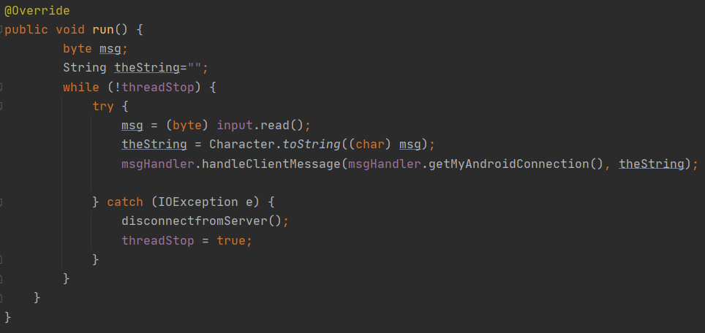
Class Client Explanation #3
Whenever a proxy client is connected to the board we get an independent thread that this client is operating on, always anticipating for messages from the board to read, change it into a type string then send to the client message handler using the handleClientMessage function.

Slide 17
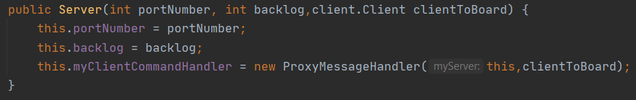
Class Server Explanation #1
This’s the server constructor, basically setting the port number, backlog, and passing a reference to the clientToBoard client to be passed in the command handler as shown in the picture. that later on we will try to connect to establish the connection using that client to connect to the board.

Slide 18
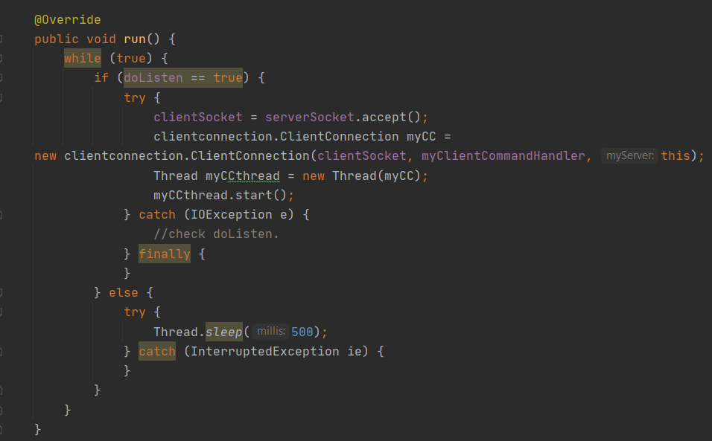
Class Server Explanation #2
Other methods in Server class were explained before, except for the run method:
This run method corresponds to myListenerThread which we start once we call the listen method as presented in slide 6, if there’s a connection established and accepted we initialize our Client Connection and start a thread specific for that client on the using that socket created.
If there’s no connection from the client within the specific period setSoTimeout(500) in listen method. Then we make the thread sleep then try again to to listen for connections, yet all of this on a separate thread from the normal thread.

Slide 19
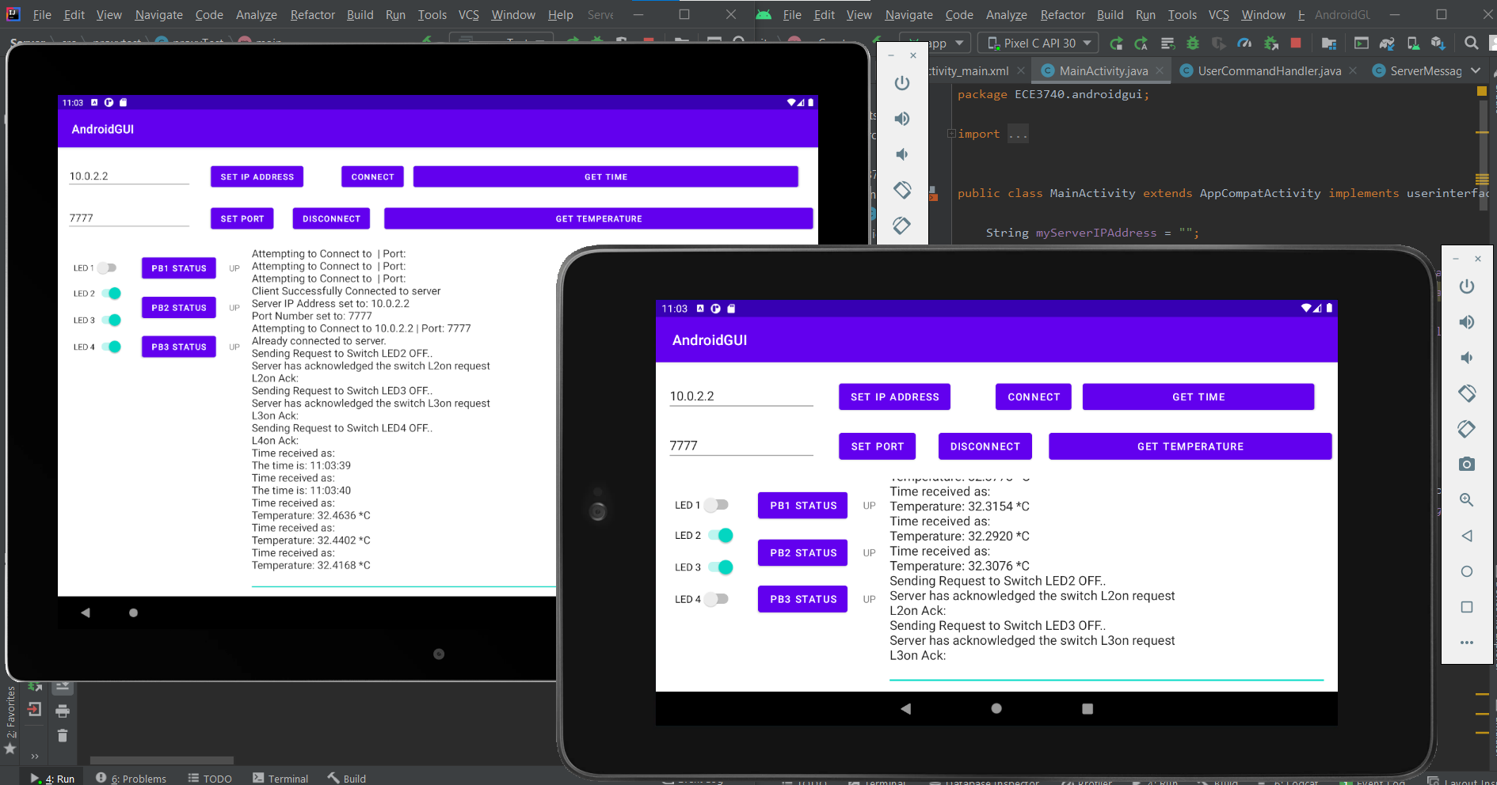
Thank you

